Slide 1

Bioartificial Kidney
Presented By: Aarsh Ashir
EN 585.729.81
06 December 2022
Notes:
Hi all,
I chose to research bioartificial kidneys for my case study and here is my presentation for it!

Slide 2

Problem Statement
Kidney failure is a major concern in today’s society.
Common current treatments:
Oral medicinal treatment
Dialysis
Organ Transplant
About 1% of the Medicare population suffers from kidney failure
Cost makes up about 6% of the Medicare budget
Figure 1: Kidney Disease
Image taken from [20]
Notes:
Kidney failure is a major concern in today’s society. Unless treated, kidney failure can be extremely fatal. Oral medicinal treatment or dialysis are a few treatment options available, but organ transplantation may be the most viable option for individuals. About 1% of the Medicare population suffers from kidney failure, while the cost makes up about 6% of the Medicare budget. The Kidney Project aspires to change this status [1].

Slide 3
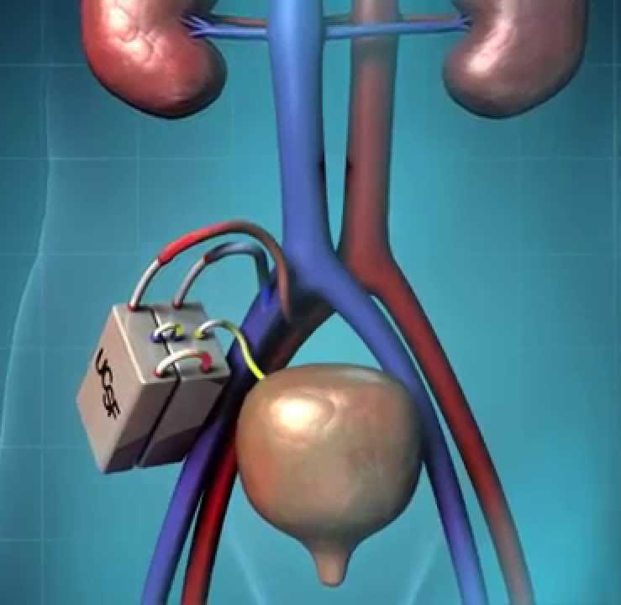
Solution - The Kidney Project
University of California, San Francisco research team
Led by Shuvo Roy and William Fissell
Small, surgically implantable bioartificial kidney
Animal & in vivo testing, with potential for clinical trials
Figure 2: The Kidney Project
Image taken from [21]
Notes:
The Kidney Project by the University of California San Francisco is a national research project currently in the process of testing a bioartificial kidney [1]. The device is a small, surgically implantable bioartificial kidney that can perform biological renal functions. At this point, the research team has conducted animal and in vivo testing, both showing promising results with hopes to test clinically in the near future. From a clinical perspective, this could help lots of individuals suffering with nephrological issues, and it could even speed up the healing process since some patients have to wait to find a proper organ donor.

Slide 4
Solution Landscape
Treatment | Description | Advantages | Disadvantages
1 | Synthetic hemofiltration devices and renal tubule cell therapy device | Helps replace filtration, transport, metabolic, and endocrinologic functions in uremic dogs | Clinical applications to be determined
2 | Bioartificial renal tubule assist devices (RAD) | Improved differentiated transport which improved metabolic and endocrinological functions of kidney | Transport functions were not as efficient
3 | Bioartificial renal tubule device that uses renal tubule epithelial cells in an artificial membrane | First successful long-term evaluation of a bioartificial renal tubule device | Cells in hollow fibers nearly obstructed the hollow fibers after 13 days
4 | Hemodialysis | Feasible, safe, efficacious, and indispensable therapy | Very demanding procedure
5 | Herbal oral treatments | Treatment is oral and less invasive | Clinical application cannot be advocated
Notes:
Here is a short list of current treatments that addresses kidney failure concerns.
Treatment 1 combines synthetic hemofiltration and renal tubule cell therapy devices that contain renal cells. The main advantage is that this can help replace the critical kidney functions. However, human clinical trials are undetermined, since this has only been tested in uremic animals.
Treatment 2 is a bioartificial renal tubule device. An advantage is the the ability to complete differentiated transport which helps to improve metabolic and endocrinological functions. However, the differentiated transport functions did not function as efficiently as natural occurring tubules.
Treatment 3 takes the renal tubule device mentioned in Treatment 2 and combines it with epithelial cells. While this option was the first successful long-term application of a bioartificial tubule, after 13 days, the cells in the hollow fibers nearly obstructed the fibers, causing complications.
Treatment 4 is the most common treatment available today. Hemodialysis is a therapeutic treatment that filters wastes and water from the blood. This is the most safe and feasible option, however, it can be a very demanding process and requires a lot of time and effort from the patient.
Treatment 5 is a unique option that involves herbal oral medicine that may modify the immune system’s response in glomerulonephritis. The biggest advantage with this is the fact that it is the least invasive, however, applications for clinical trials are not promising.

Slide 5
Solution Description
# | Criteria | Unit of Measure | Ideal Value
1 | Functionality | GFR ml/min | 60 ml/min
2 | Size | Centimeters / Inches | 10 - 12cm (5in)
3 | Structure | Micrometers | 200 μm
4 | Manufacturability | Years | 3 - 5 years
5 | Cost | U.S. Dollars | Kidney Transplant Price (~$442,500)
6 | Longevity | Years | Permanent
Notes:
A list of criteria is generated to further help with creating a solution for this problem.
Criteria 1 focuses on the functionality, whether or not the device mimics renal functions.
Criteria 2 focuses on the size of the device and how it must mimic patient’s existing organ.
Criteria 3 focuses on the structure, specifically if the device has a biocompatible scaffold and is non-toxic to cells and recipient.
Criteria 4 focuses on manufacturability, specifically the time it takes for patient to receive device.
Criteria 5 focuses on the cost of the device and how it should be based on population intended to use. Criteria 6 focuses on the longevity of the device, specifically the durability of device construct.
The basis of the Kidney Project builds upon the existing renal assist device (RAD) that “combines a membrane hemofilter and a bioreactor of human renal tubule cells.” However, the large size of the RAD causes labor-intensive and complex operations. By applying microelectrical systems (MEMS) and nanotechnology, the Kidney Project is able to downsize the RAD into an implantable bioartificial kidney, offering a more suitable option for patients. This aspect fulfills Criteria 2 and 3 since the device is compact and easily implantable.
The device is also able to process blood continuously for 24 hours per day after a permanent blood connection is established. This aspect fulfills Criteria 1 in the sense that the device is able to continuously filter blood.
The device is also coated with a special thin biocompatible film, therefore, fulfilling Criteria 6 because the film prevents blood clots, ultimately preventing transplant rejection.
Using silicon nanotechnology, the team was able to create a highly efficient compact membrane that allows the device to perform filtration without pumps or a power supply. Additionally, the team utilized a bioreactor to grow and maintain renal tubule cells. These design components fulfill Criteria 1 and 6 in the sense that the device is able to emulate biological renal functions.
The research team anticipates that the device will cost about the same as a normal kidney transplant, therefore fulfilling Criteria 5 and hope that this device can speed up a patient’s waiting time to receive a transplant since the patient would not have to wait for an organ donor or a proper organ match, therefore, fulfilling Criteria 4.

Slide 6
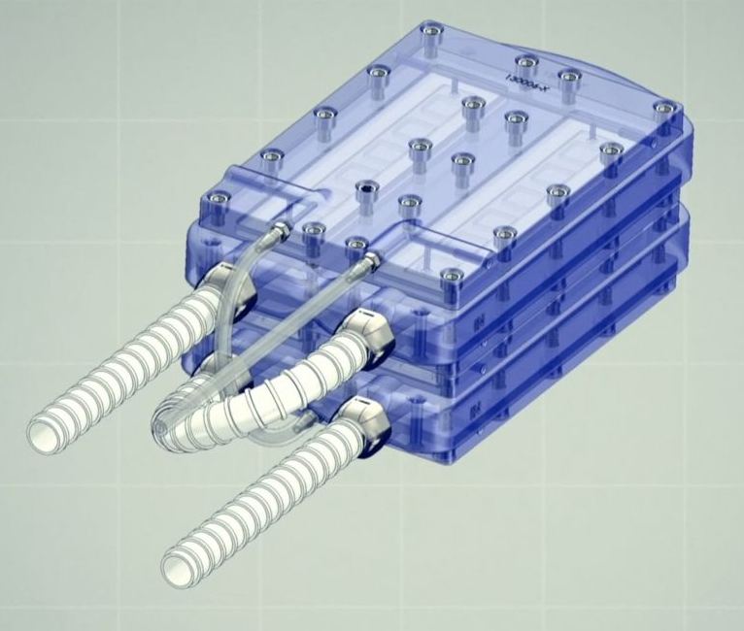
Verification & Validation
Verification:
2019 - tested bioreactor component in large pigs
Also tested in vivo
Validation:
Testing in large animals with compromised kidney function
Initial clinical trial to focus on testing hemofilter components
Testing bioreactor and hemofilter for safety and effectiveness
Figure 3: Bioartificial Kidney Prototype
Image taken from [14]
Notes:
In 2019, the team was able to implant a prototype kidney bioreactor in a group of large animals without consequential safety concerns. To prevent immune system rejection, the team created an immunoprotection chamber using silicon nanopore membranes (SNM) and tested the functionality of the cells in a benchtop model and in vivo. The team coated the SNM filters with biologically friendly molecules.
In the benchtop model, the team developed a dual-chamber vessel with human RTC confined by SNM and was able to assess the viability and monolayer integrity of the RTC.
The results for the benchtop model showed that RTC were >90% viable. The results exhibit major progress towards scaling-up the bioreactor to a larger number of cells to test whether or not the implanted device can complement kidney functions in animals with kidney failure. By coating the SNM filters with biologically friendly molecules, the device can prevent blood clots or critical immunogenic responses, which is a major proof of concept.
The hemofilter component has been implanted into large pig animal models for up to 1 month [5]. These animals responded without serious complications such as immune rejection or cardiovascular difficulties. The team is moving forward with implementing the device into large animals with compromised kidney function for up to 30 days. Clinical testing for the device will take a few years, but the Kidney Project initial clinical trial is focused on evaluating material safety of the hemofilter component. During this trial, the team will verify if all hemofilter materials are compatible and safe for human blood exposure. Once these clinical trials are complete, and if the results are promising, the bioartificial kidney will be available to the public. The team predicts to begin testing for the hemofilter material safety in 2022, assuming they have sufficient funding and no unanticipated drawbacks.

Slide 7
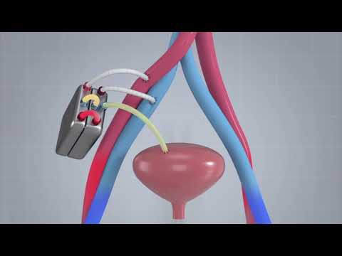
Conclusion
Ultimate Goal:
Emulate kidney filtration, balancing, and other biological functions
The Kidney Project aims to address the concerns associated with total kidney failure.
Video 1: Kidney Project successfully tests a prototype
Video taken from [14]
Notes:
Chronic kidney disease is a continuing health issue that can lead to end stage renal disease which can be extremely fatal. Therefore, there is a demanding need for an effective and safe treatment that is cost friendly as well.
The ultimate goal of the artificial kidney is to emulate kidney filtration, balancing, and other biological functions.
With promising results demonstrated with animal and in vivo testing, the research team anticipates first-in-human clinical trials in the next few years. The Kidney Project, led by the University of California, San Francisco aims to address these concerns associated with Chronic kidney disease with their bioartificial kidney device and wish to restore a sense of hope and faith to those suffering from kidney failure.
Here is a video that gives a short summary of the team’s achievements so far.

Slide 8
References
[1] “Need for Kidney Transplants Â·.” The Kidney Project, pharm.ucsf.edu/kidney/need.
[2] Humes, H. David, et al. “Replacement of Renal Function in Uremic Animals With a Tissue-engineered Kidney.” Nature Biotechnology, vol. 17, no. 5, Springer Science and Business Media LLC, May 1999, pp. 451–55. https://doi.org/10.1038/8626.
[3] Humes, H. David, et al. “Tissue Engineering of a Bioartificial Renal Tubule Assist Device: In Vitro Transport and Metabolic Characteristics.” Kidney International, vol. 55, no. 6, Elsevier BV, June 1999, pp. 2502–14. https://doi.org/10.1046/j.1523-1755.1999.00486.x
[4] Ozgen, N., et al. “Evaluation of Long-term Transport Ability of a Bioartificial Renal Tubule Device Using LLC-PK1 Cells.” Nephrology Dialysis Transplantation, vol. 19, no. 9, Oxford UP (OUP), July 2004, pp. 2198–207. https://doi.org/10.1093/ndt/gfh399.
[5] Elliott, Denise A. “Hemodialysis.” Clinical Techniques in Small Animal Practice, vol. 15, no. 3, Elsevier BV, Aug. 2000, pp. 136–48. https://doi.org/10.1053/svms.2000.18297.
[6] Journal of Pharmacognosy and Phytotherapy. Academic Journals, 2009. https://doi.org/10.5897/JPP.9000028 (https://academicjournals.org/journal/JPP/article-full-text-pdf/249290F3712)

Slide 9
References
[7] “Uremia: Complications, Causes, Symptoms and Treatment.” Cleveland Clinic, my.clevelandclinic.org/health/diseases/21509-uremia. Accessed 25 Oct. 2022.
[8] “Explaining Your Kidney Test Results: A Tool for Clinical Use.” National Institute of Diabetes and Digestive and Kidney Diseases, 25 Oct. 2022, www.niddk.nih.gov/health-information/professionals/advanced-search/explain-kidney-test-results.
[9] “What Is Kidney Atrophy?” National Kidney Foundation, 15 Aug. 2022, www.kidney.org/atoz/content/what-kidney-atrophy.
[10] Freedman, Benjamin S., and Buddy Ratner. “Building Scaffolds to Rebuild Kidneys.” ACS Central Science, vol. 5, no. 3, American Chemical Society (ACS), Feb. 2019, pp. 380–82. https://doi.org/10.1021/acscentsci.9b00099.
[11] NHS website. “Waiting List.” nhs.uk, 7 Sept. 2022, www.nhs.uk/conditions/kidney-transplant/waiting-list.
[12] Statista. “Breakdown of Charges for a Kidney Transplant in the U.S. in 2020, by Category.” Statista, 6 Mar. 2020, www.statista.com/statistics/1100710/organ-transplantation-costs-breakdown-us.
[13] “The Kidney Project.” University of California San Francisco, pharm.ucsf.edu/kidney.

Slide 10
References
[14] “The Kidney Project Successfully Tests a Prototype Bioartificial Kidney.” UCSF School of
Pharmacy, 13 Jan. 2022, pharmacy.ucsf.edu/news/2021/09/kidney-project-successfully-tests-prototype-bioartificial-kidney.
[15] “Bioartificial Kidney Aims to Mimic Natural Kidney Function With $1.” UCSF School of Pharmacy, 13 Jan. 2022, pharmacy.ucsf.edu/news/2020/10/bioartificial-kidney-aims-mimic-natural-kidney-function-1-million-grant-john-marcia.
[16] “Implantable Bioartificial Kidney Achieves Preclinical Milestone.” UCSF School of Pharmacy, 13 Jan. 2022, pharmacy.ucsf.edu/news/2019/11/implantable-bioartificial-kidney-achieves-preclinical-milestone.
[17] Nesbitt, Hal. “American Society of Nephrology | Kidney Week - Abstract Details (2019).” ASN Mobile, www.asn-online.org/education/kidneyweek/2019/program-abstract.aspx?controlId=3232240.
[18] “Frequently Asked Questions by Patients Â·.” The Kidney Project, pharm.ucsf.edu/kidney/device/faq.
[19] “The Kidney Project Wins KidneyX Award to Enable Simpler, Safer.” UCSF School of Pharmacy, 13 Jan. 2022, pharmacy.ucsf.edu/news/2020/07/kidney-project-wins-kidneyx-award-enable-simpler-safer-home-dialysis.

Slide 11
References
[20] Kidney Disease Clipart - Clip Art Library. clipart-library.com/clipart/1023257.htm.
[21] Kindy, David. “This Bioartificial Organ Could One Day Save 'Millions' Living With Kidney Disorders.” Smithsonian Magazine, 21 Sept. 2021, www.smithsonianmag.com/smart-news/this-bioartificial-organ-could-one-day-save-millions-suffering-kidney-disorders-180978721.

